Slide 1
Chapter 5: Dynamic Analysis-Test Design Techniques
Software Testing
Equivalence Class Portioning and Boundary Value Analysis

Slide 2


Black Box Testing
Motivation?
Real life examples like Car, Bulb, Speaker etc

Slide 3
Black Box Testing
Testing software without knowledge of internal implementation details
–Can be applied to software “units”
–External behavior is defined in functional requirements
Focus on input and output
Examines the functionality of an application
Checks for valid and invalid conditions / inputs
Finds defects like: Incorrect functions, behaviour etc.
The Goal: Derive sets of input conditions (test cases) that fully exercise the external functionality

Slide 4
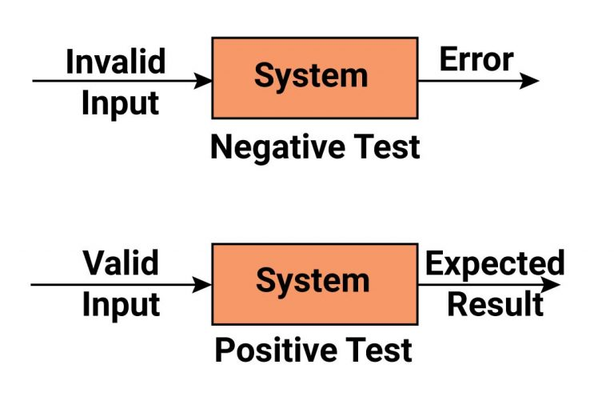
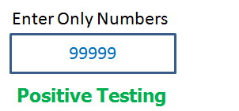
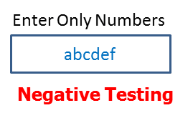
Positive and Negative testing
Positive testing to check that the product does what it is supposed to
- Behaves correctly when given right inputs
- Maps to a specific requirement“
- Coverage” is defined better
- Example: Text box in an application
Negative testing to show that the product does not fail when given unexpected
inputs
- Tries to break the system
- No direct mapping to a specific requirement“
- “Coverage” more challenging
- Example: Text box in an application

Slide 5
Black Box Techniques

Slide 6
Equivalence Class Partitioning
Motivation:
Complete testing
Avoid test redundancy
Equivalence class partitioning:
Black box testing technique
Typical defects like Wrong handling of data/domain values
Partitions are frequently derived from the requirements
Inputs to the software are divided into groups that are expected to exhibit similar behavior.
Non empty subsets
Selecting one input from each group to design the test case.
Can be used at any level of testing
Equivalence Partitioning = Equivalence Class Partitioning = ECP

Slide 7
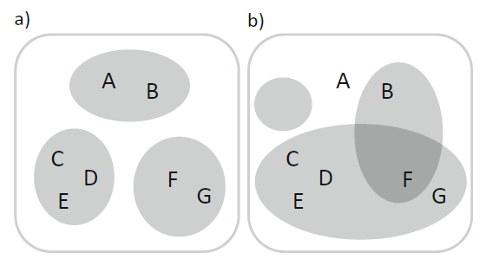
Example of Good and Wrong Partition
a) Correct EP b) Incorrect EP
1. There is an empty partition.
2. Element A does not belong to any partition.
3. Element F belongs to two different partitions.

Slide 8
Equivalence Class Partitioning
How to calculate coverage?
- Number of class from which we selected the elements to tests, divided by
the total number of all identified equivalence classes.
Example: P1 = {1, 2, 3}, P2 = {4, 5, 6}, P3 = {7, 8}, and a set {1, 4} of test input values, the coverage is 2/3 66% because we covered only P1 and P2. If we add 2 as the third test input value, we don’t increase the coverage, because 2 belongs to the same class as 1, which is already in our test set.
On the other hand, if we add a test with the input value 8, the set {1, 4, 8} of test values achieves 100% coverage, as we covered all the equivalence classes.

Slide 9
Equivalence Class Partitioning
Test cases are designed to cover each partition at least once.
Two test cases are equivalent
- Both follow same path
- Only select one test case
It’s technique where input values set into classes for testing.
- Valid Input Class = Keeps all valid inputs.
- Invalid Input Class = Keeps all Invalid inputs.

Slide 10
Equivalence Class Partitioning
Partitions of the input set
Entire input set is covered
Disjoint classes
Test cases
Equivalence classes have to be chosen wisely
All possible test cases is so large
Select a relatively small number of test cases
Which test cases should you choose?
-Equivalence Classes

Slide 11
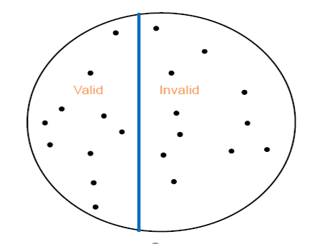
Equivalence Class Partitioning
First level portioning: valid vs Invalid input/data

Slide 12
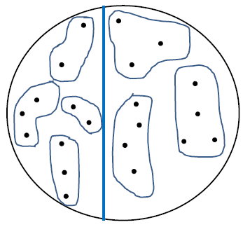
Equivalence Class Partitioning
Partition valid and invalid data into equivalence classes

Slide 13
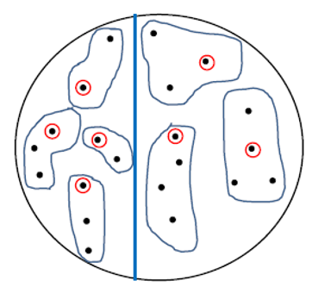
Equivalence Class Partitioning
Create a test case for atleast one value from each equivalence class

Slide 14
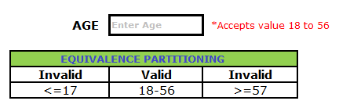
Equivalence Class Partitioning Example 1
Assume, we have to test a field which accepts Age 18 – 56.
Valid Input: 18 – 56
Invalid Input: <=17, >=57
Valid Class 1: 18 – 56
Invalid Class 2: <=17
Invalid Class 3: >=57
so we have one valid and 2 invalid classes

Slide 15
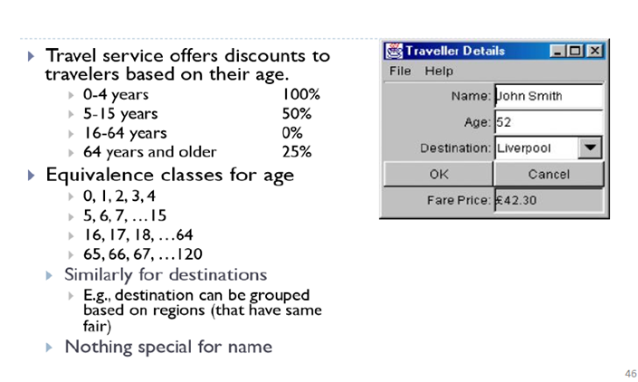
Equivalence Class Partitioning Example 2

Slide 16

Equivalence Class Partitioning Example 3
Pizza order application
Requirements:
Pizza values 1 to 10 is considered valid. A success message is shown.
While value 11 to 99 are considered invalid for order and an error message will appear, "Only 10 Pizza can be ordered“
Test Conditions and Partitions:
Any Number greater than 10 entered in the Order Pizza field(let say 11) is considered invalid.
Any Number less than 1 that is 0 or below, then it is considered invalid.
Numbers 1 to 10 are considered valid
Any 3 Digit Number say 100 is invalid.

Slide 17
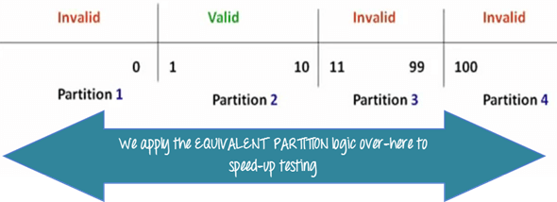
Equivalence Class Partitioning Example 3
Divide the possible values of pizza number into groups or sets as shown below.

Slide 18
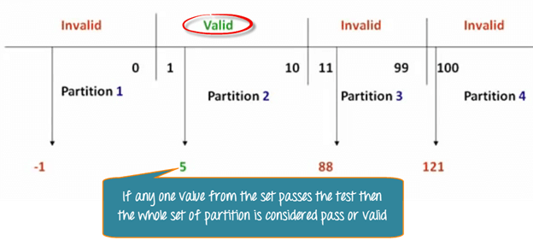
Equivalence Class Partitioning Example 3
Pick only one value from each partition for testing

Slide 19
Equivalence Class Partitioning Example 3
S# | Equivalence Partition | Type of Input | Test Data | Expected Result
1 | Number 1-10 | Valid | 10 | “Successfully Ordered 10 Pizza”
2 | Number < 1 or 0 | Invalid | -1 | “Invalid Order”
3 | 10<Number<=99 | Invalid | 88 | “Only 10 Pizza can be ordered”
4 | Number>100 | Invalid | 121 | “Only 10 Pizza can be ordered”
Table. Equivalence partitioning for Pizza order application

Slide 20
Summary of the process of ECP
Choose criteria for ECP (range, list of values, etc.).
Identify the valid and invalid EC .
Select a sample data from that partition.
Write the expected result based on the requirements given.
Identify special values, if any, and include them in the table.
Check to have expected results for all the cases prepared
If the expected result is not clear for any particular test case, mark appropriately and escalate for corrective actions.
If you cannot answer a question, or find an inappropriate answer, consider whether you want to record this issue on your log.

Slide 21
Advantages and Disadvantages of ECP
Advantages:
Reduces the number of test cases.
Reduce execution time
Can be applied at any level of testing
Used where exhaustive testing is not possible
Maintain good test coverage.
Disadvantages:
Not consider the boundary conditions.
Equivalence classes relies heavily on the expertise of the tester
Too large partitions leads to risk of missing defects
Assumption for result of correct input data set

Slide 22
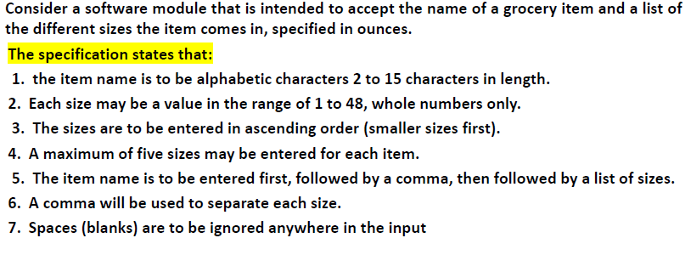
Class Task

Slide 23
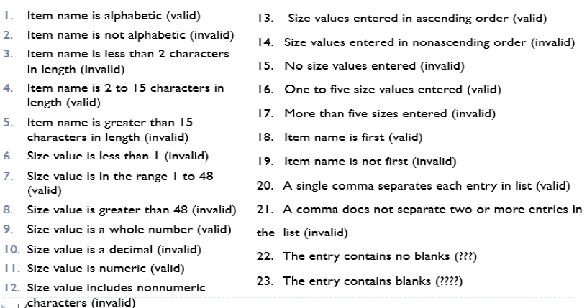
Class Task (Solution)
Derived Equivalence Classes

Slide 24
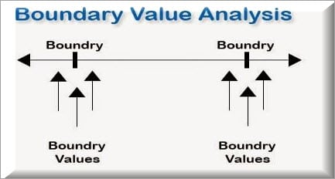
Boundary Value Analysis
Motivation:
Errors at extreme ends.
Boundary Value Analysis:
Based on testing boundary values
Maximum and minimum of every partition
Covers both valid and invalid boundary values
Used to identify errors that arise due to the limits of input data.

Slide 25
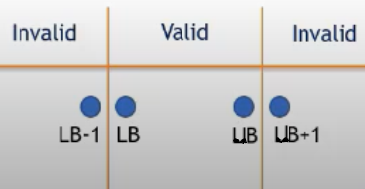
Boundary Value Analysis
Choose the values that cause the program to fail
Errors occur at boundary rather in center
Test boundary values
– Right on a boundary
– Close to a boundary on either side
For each boundary, we test +/-1 in the least significant digit of either side of the boundary.
Boundary values are calculated as LB,LB-1, UB, UB+1

Slide 26
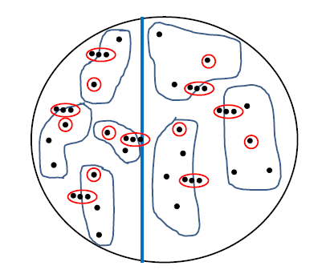
Boundary Value Analysis
Create test cases to test boundaries of equivalence classes

Slide 27
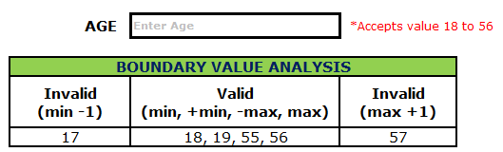
Boundary Value Analysis Example 1
Assume, we have to test a field which accepts Age 18 – 56
Minimum boundary value is 18
Maximum boundary value is 56
Valid Inputs: 18,19,55,56
Invalid Inputs: 17 and 57

Slide 28
Test Cases for Example 1
Test cases for input box accepting numbers between 18 and 56 using Boundary value analysis:
- Test cases with test data exactly as the input boundaries of input
domain i.e. values 18 and 56 in our case.
- Test data with values just below the extreme edges of input domains
i.e. values 17 and 55.
- Test data with values just above the extreme edges of the input
domain i.e. values 19 and 57

Slide 29
Test Cases for Example 1
Test case 1: Enter the value 17 (18-1) = Invalid
Test case 2: Enter the value 18 = Valid
Test case 3: Enter the value 19 (18+1) = Valid
Test case 4: Enter the value 55 (56-1) = Valid
Test case 5: Enter the value 56 = Valid
Test case 6: Enter the value 57 (56+1) =Invalid

Slide 30

Boundary Value Analysis Example 2
Pizza order application
Requirements:
Pizza values 1 to 10 is considered valid. A success message is shown.
While value 11 to 99 are considered invalid for order and an error message will appear, "Only 10 Pizza can be ordered“
Test Conditions and Partitions:
Any Number greater than 10 entered in the Order Pizza field(let say 11) is considered invalid.
Any Number less than 1 that is 0 or below, then it is considered invalid.
Numbers 1 to 10 are considered valid
Any 3 Digit Number say 100 is invalid.

Slide 31
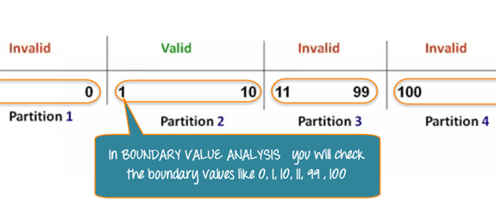
Boundary Value Analysis Example 2
In BVA,we test boundaries between equivalence partitions

Slide 32
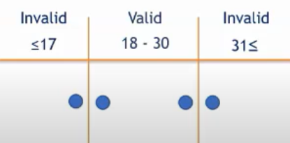
Boundary Value Analysis Example 3
A text field in an application accepts input as the age of the user. Here, the values allowed to be accepted by the field is between 18to 30 years, inclusive of both the values. By applying Boundary value analysis what is the minimum number of test cases required for maximum coverage.
2
3
1
4 Ans

Slide 33
Advantages and Disadvantages of BVA
Advantages:
Density of defects at boundaries is more
Overall execution time reduces
Best for physical quantities
Disadvantages:
Incorrect EC leads to incorrect BVA
Not suitable for input value depends on the decision of another value
Not fit for Boolean and logical

Slide 34
Thank you

